Slide 1
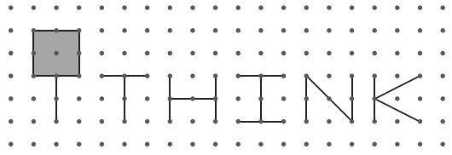
Case Study – Resolvr by: ( Data Analytics )
The Smart Cube
Shivam Sharma
(Speaker 1)
Gargi Trivedi
(Speaker 2)
Hemant Talan
(Speaker 3)
Ankit Malik
(Speaker 4)
Case Study: Approach & Solution

Slide 2
Content
OVERVIEW OF OUR APPROACH..................................................................................................1
MISSING VALUES AND OUTLIERS……………………………………………………………………...…………………...2
DATA PREPROCESSING……………………………………………………………………………………………………………3
EXPLORATORY DATA ANALYSIS………………………………………………………………………………………………..4
MACHINE LEARNING MODELS………………………………………………………………………………………………..5
INSIGHT GENERATED………………………………………………………………………………………..…………………….7
BIBLIOGRAPHY………………………………………………………………………………………..……………………………..9
Case Study: Approach & Solution

Slide 3
Overview Of Our Approach
Blue Delta Airways, a well-known budget airline company operating primarily in the US and Europe, has observed a decline in the number of flyers over the past year. In view of the declining customer base, the company has collected data on customer satisfaction – based on several personal and services-based attributes. Data driven insights can be obtained using our analysis and approach
iTHINK-led Approach :
Using Data provided by British Delta Airways iTHINK applied analytical techniques to impute, scale and remove outliers of data according to suitability of parameters
iTHINK dive deep and extrapolated unique insights from data by various visualization methods
iTHINK applied different Machine learning algorithms and validated performance metrics to predict customer satisfaction .Parameters having key significance were sorted by their impact.
Insight Generated :
iTHINK-led approach extracted most important parameters that influence customer satisfaction.
This insight will enable Blue Delta Airways to design better targeted marketing campaigns and special offers to arrest the attrition of its customer base
Case Study: Approach & Solution 1

Slide 4
MISSING VALUES AND OUTLIERS
Total Values in dataset | Total Attributes | Total Missing Values
129880 | 21 | 441
TABLE 1
Technique used for missing value imputation
Mean | Median | Majority
Rating Attributes | Quantified features that ranges between 0 and infinity | All the unquantified features
[Gate location, Inflight Wi-Fi service, Departure/Arrival time convenient etc.] | [Arrival Delay in Minutes, Flight Distance] | [Gender , Class , Type of travel, Customer Type]
TABLE 2
Outliers
AGE | DEPARTURE DELAY (Min) | Flight Distance
Less than 17 years[1] | Greater than 400 (99.9 percentile value is 383 ) | Greater than 4000 units (99.9 percentile value is 3996)
TABLE 3
Case Study: Approach & Solution 2

Slide 5
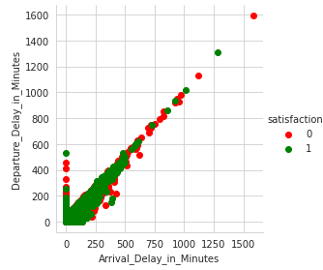
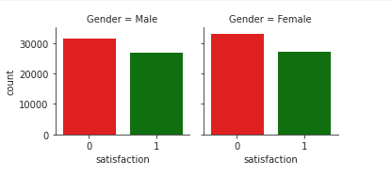
DATA PREPROCESSING
NEW RATINGS
Rating 3 considered as neutral feedback
Rating 1 and 2 considered as negative feedback
Rating 4 and 5 considered as Positive feedback
3
2
1
1. Gender Neutral :
Dropped gender feature for avoiding biasness
Also it is not giving any conclusive insight
FIG 2
2.Arrival delay Vs Departure delay:
Due to linearity between departure delay and arrival delay
We can choose any of these two features for further modeling[2]
We dropped Arrival delay field because of more missing values.
FIG 1
Case Study: Approach & Solution 3

Slide 6
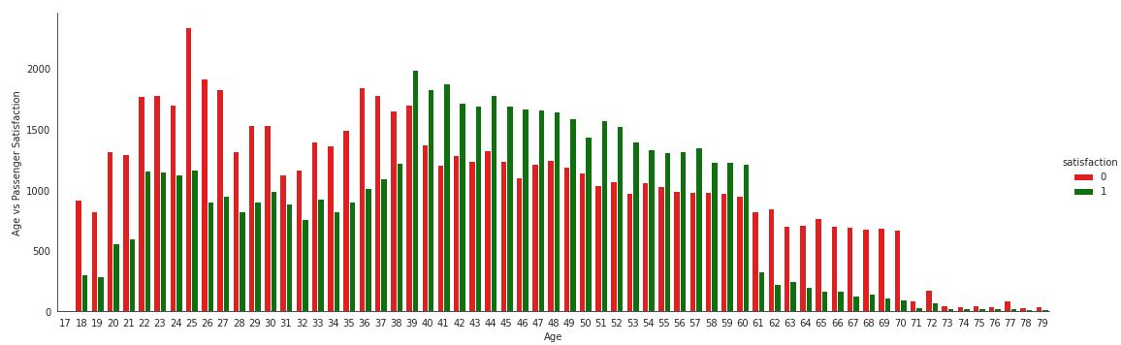
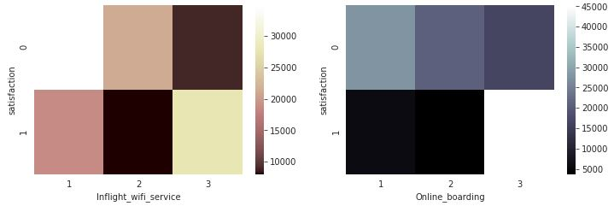
EXPLORATORY DATA ANALYSIS
AGE:
Passenger between 17-38 and senior citizens (above 60) are more unsatisfied than 38-60 age group
FIG 5
REMARKS :
Various univariate as well as multivariate analysis suggests that, as rating increases the satisfaction level also increases.
There is no perfect multicollinearity in data. Hence we are
not discarding any other variable.
For any conclusive remarks we need to analyze data with some advance Data analytics modeling.
FIG 3
FIG 4
Case Study: Approach & Solution 4

Slide 7
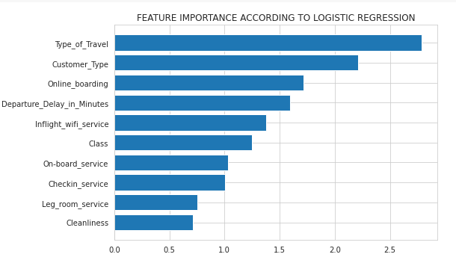
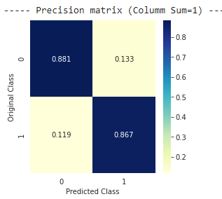
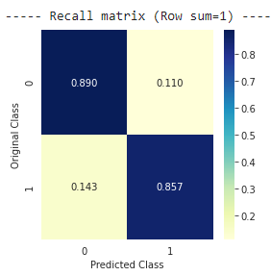
MACHINE LEARNING MODELS
The best performance achieved among different classification algorithms are discussed.
Each data sample has 20 features
Training set : 95896 samples
Test set : 23975 samples
Encoding Technique : Label encoding
Scaling : Minmax Scalar
Modeling Algorithms : Logistic Regression, Linear SVM,
Random Forest , XGBoost , LGBM Classifier
Performance parameters used for Model validation are
Accuracy
Log loss[8]
Precision matrix[9]
Recall Matrix[10]
1. LOGISTIC REGRESSION
Accuracy : 87.48%
Log Loss : 0.3271
FIG 6
Case Study: Approach & Solution 5

Slide 8
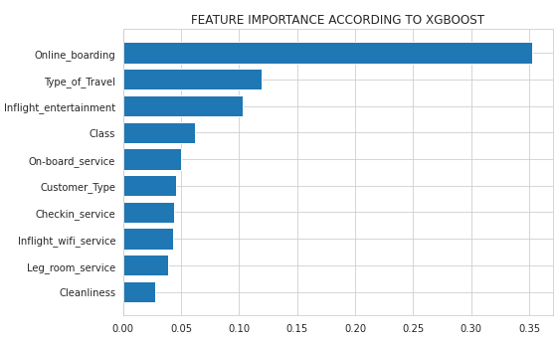
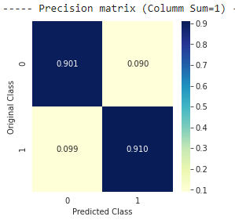
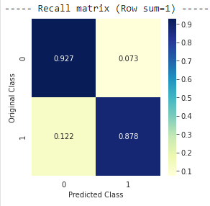
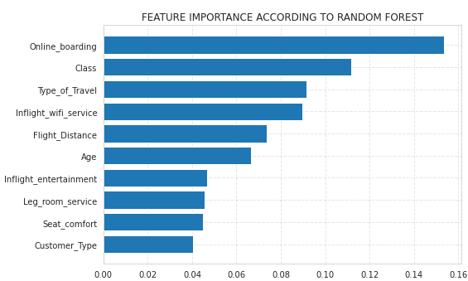
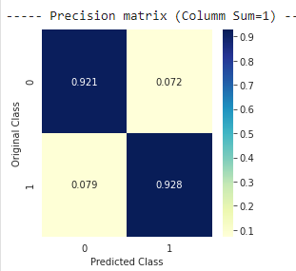
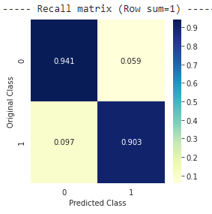
2. Xgboost :
Accuracy : 89.91%
Log Loss : 0.2409
3. Random Forest :
Accuracy : 92.38
Log loss : 0.1937
FIG 7
FIG 8
Case Study: Approach & Solution 6

Slide 9
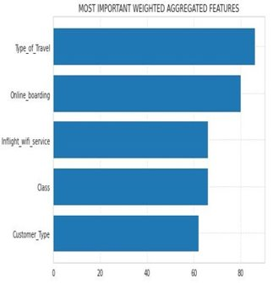
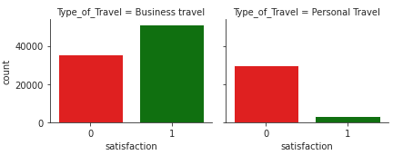
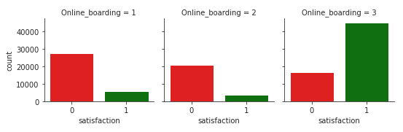
INSIGHT GENERATED
1. Type Of Travel
59% Business travelers are satisfied customers while only 10% personal travelers are satisfied.
Also More flight distance is travelled by business travelers.
Inference :1. Target audience is business travelers[7].
2. Schemes to engage personal travelers can be initiated.
FIG 10
2. Online Boarding
Only 15% Customers who gave overall negative feedback had rated satisfaction with the Online Boarding services.
Inference: Online boarding facility should be maintained.
FIG 9
FIG 11
Case Study: Approach & Solution 7

Slide 10
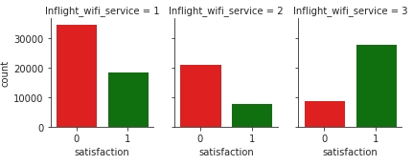
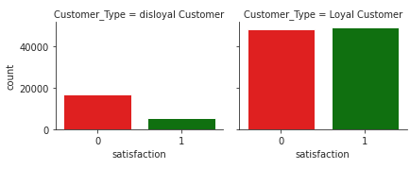
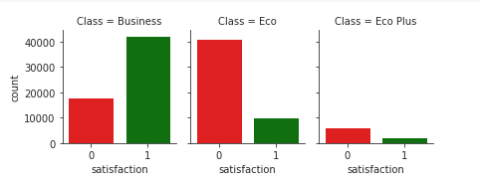
3. Inflight Wi-Fi Service
4. Class
5. Customer Type
Among the class types, business class has 70% customers with positive experience and Eco /Eco plus class has only 19% satisfied customers .
Inference : 1. special offers to retain business class customers.
2.Improve eco and eco plus facilities.
FIG 12
FIG 14
Only 11% customers who gave overall negative/neutral feedback had rated dissatisfaction with the Wi-Fi services.
Inference : Improve Wi-Fi service
48% loyal customers are satisfied while only 24% of disloyal customers.
Inference : 1. Improve first time experience of customers.
2. special offers to arrest the attrition of customer base
FIG 13
Case Study: Approach & Solution 8

Slide 11
Bibliography
1. Age Policy : www.airport-parking-shop.co.uk/info
2. Linear Dependence, or Exact Multicollinearity : https://rip94550.wordpress.com/
3. seaborn.catplot : https://seaborn.pydata.org/generated/seaborn.catplot.html
4. Categorical features : www.catboost.ai/docs/features/categorical-features.html
5. How to Remove Outliers for Machine Learning /Jason Brownlee :www.machinelearningmastery.com
6. Logistic regression : www.wikipedia.com/Logistic_regression
7. How brands are targeting business travellers : www.econsultancy.com
8. Loss functions for classification : https://en.wikipedia.org/wiki/Loss_functions_for_classification
9. Precision (statistics) : https://en.wikipedia.org/wiki/Precision_(statistics)
10. Precision and recall : https://en.wikipedia.org/wiki/Precision_and_recall
Case Study: Approach & Solution 9

Slide 12

Netaji Subhas University of Technology Masters in Technology (Signal Processing)
Team Profile
Shivam Sharma
Roll No. 2019PSP3020
Gargi Trivedi
Roll No. 2019PSP3023
Hemant Talan
Roll No. 2019PSP3007
Ankit Malik
Roll No 2019PSP3005
Case Study: Approach & Solution

